Slide 1
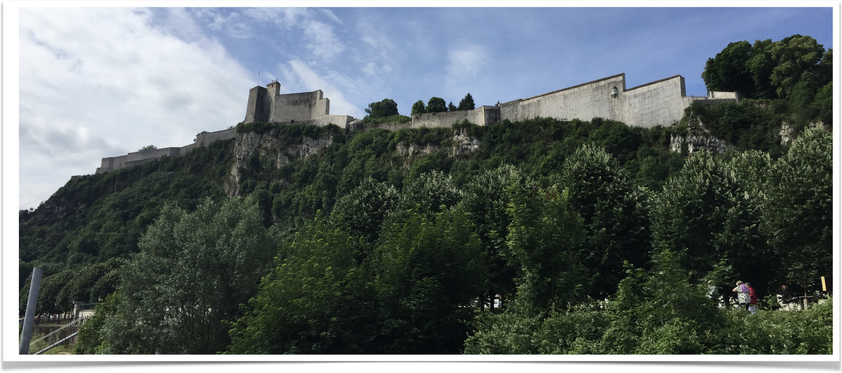
A&M FRANCE MATHEMATICS IN BESANÇON
Study Abroad Program
Summer I 2020

Slide 2
WHAT IS THIS PROGRAM?
5-week long 6-credit program
MATH 409 Advanced Calculus I (3 credits)
MATH 485 Directed Studies (group project 3 credits)

Slide 3
WHEN DOES IT HAPPEN?
Summer I 2020.
From Monday May 26, 2020 to Sunday June 27, 2020.

Slide 4
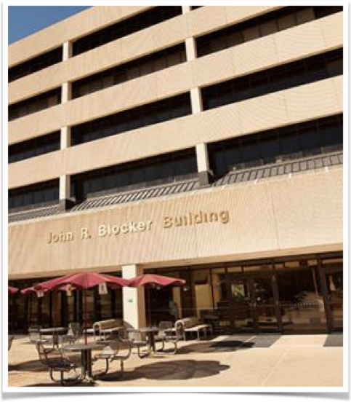
WHERE WILL YOU GO FIRST?
two weeks on campus in College Station (May 26-June 6)

Slide 5
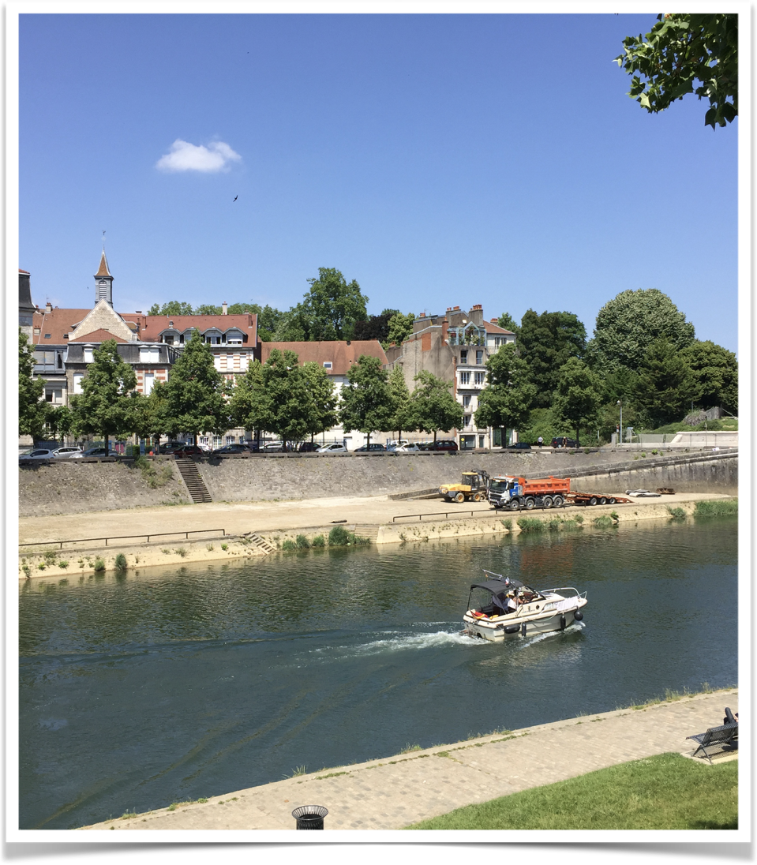
WHERE WILL YOU GO NEXT?
BESANÇON, FRANCE (3 weeks, June 7-June 27)

Slide 6
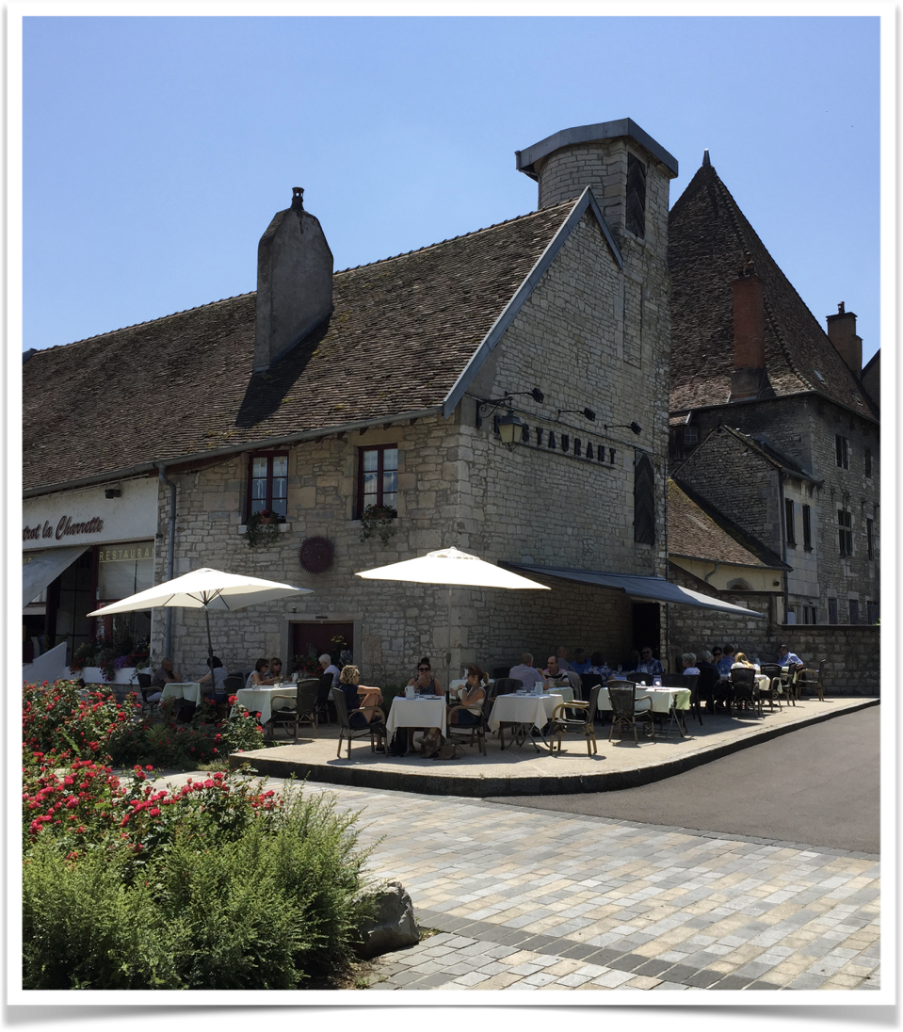
WHERE WILL YOU GO NEXT?
BESANÇON, FRANCE (3 weeks, June 7-June 27)
The City of Time

Slide 7
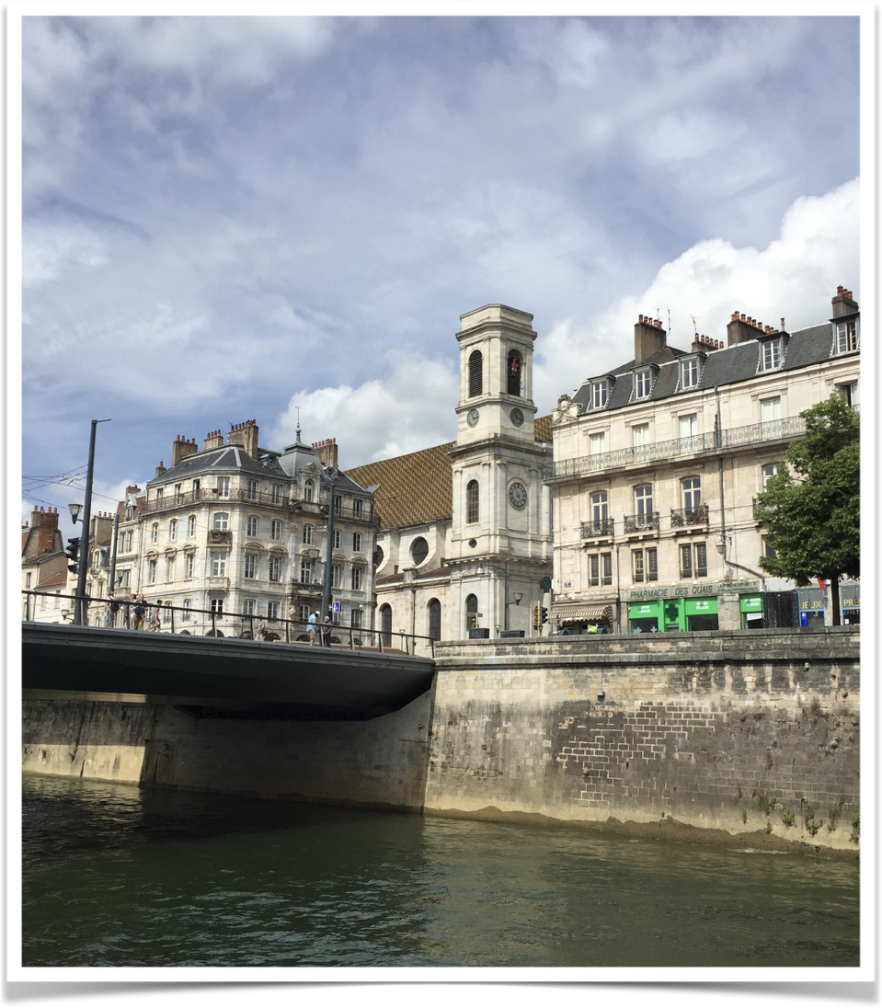
WHERE WILL YOU GO NEXT?
BESANÇON, FRANCE (3 weeks, June 7-June 27)
The City of Time
Birthplace of Victor Hugo,

Slide 8
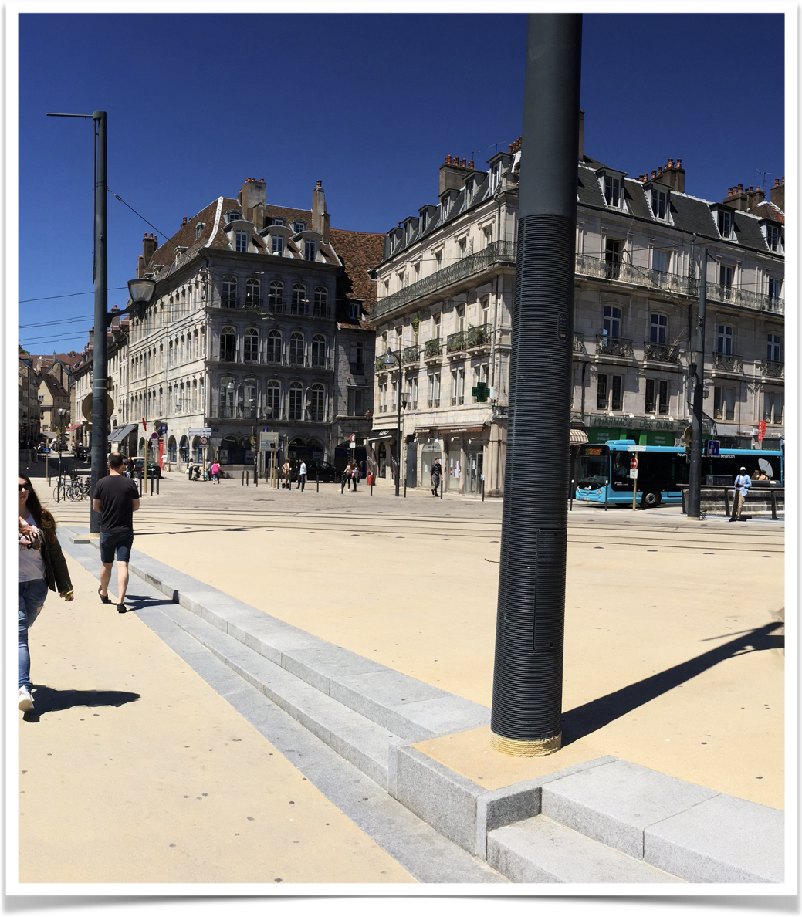
WHERE WILL YOU GO NEXT?
BESANÇON, FRANCE (3 weeks, June 7-June 27)
The City of Time
Birthplace of Victor Hugo,
Auguste and Louis Lumière

Slide 9
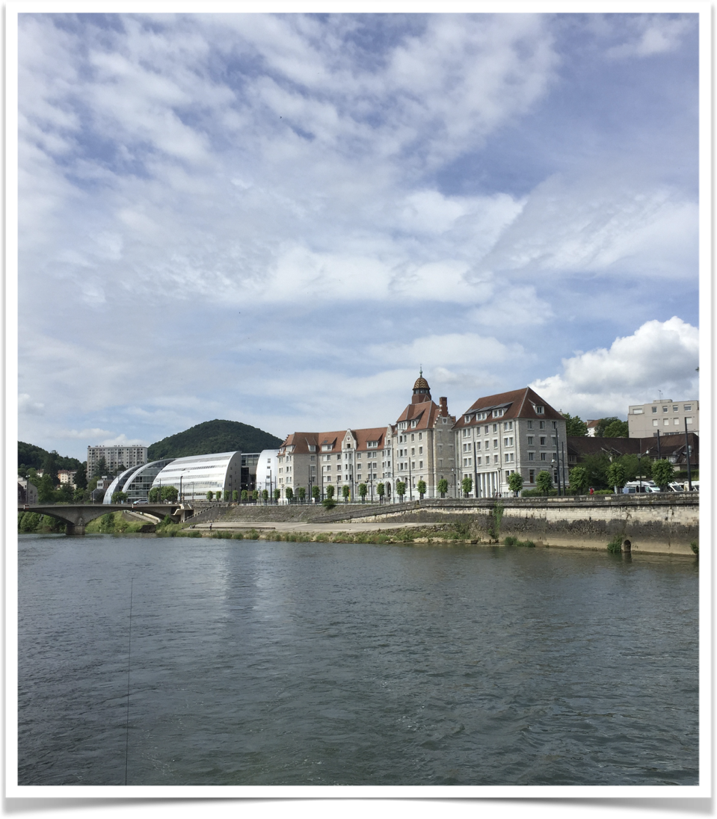
WHERE WILL YOU GO NEXT?
BESANÇON, FRANCE (3 weeks, June 7-June 27)
The City of Time
Birthplace of Victor Hugo,
Auguste and Louis Lumière
UNESCO World Heritage Site

Slide 10
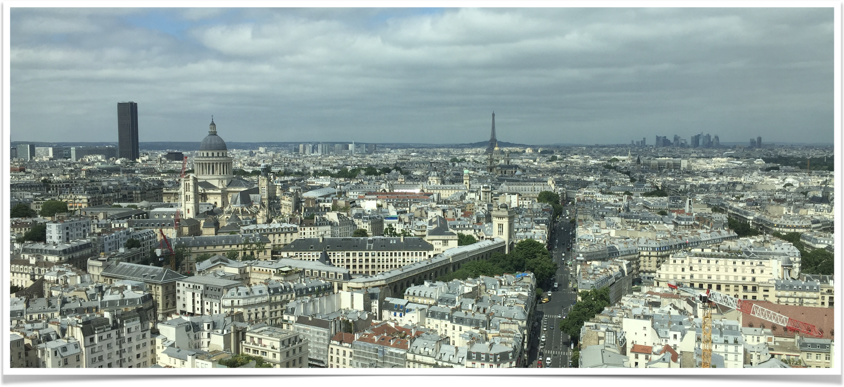
AND A WEEK END IN...
La Ville Lumiere
PARIS

Slide 11
      WHO QUALIFIES FOR THE PROGRAM?
Priority will be given to students who completed by the end of Fall 2019:
MATH 220 or MATH 300 (preferably with an A)
MATH 221 or MATH 251 or MATH 253 (A/B)
NO major restriction (students in sciences, engineering, law school, liberal arts... fulfilling the prerequisites) can apply.

Slide 12
WHO WILL GO?
Students in good academic standings.
Students who fulfill the prerequisites.
Students that will be approved by the program leader after being interviewed.

Slide 13
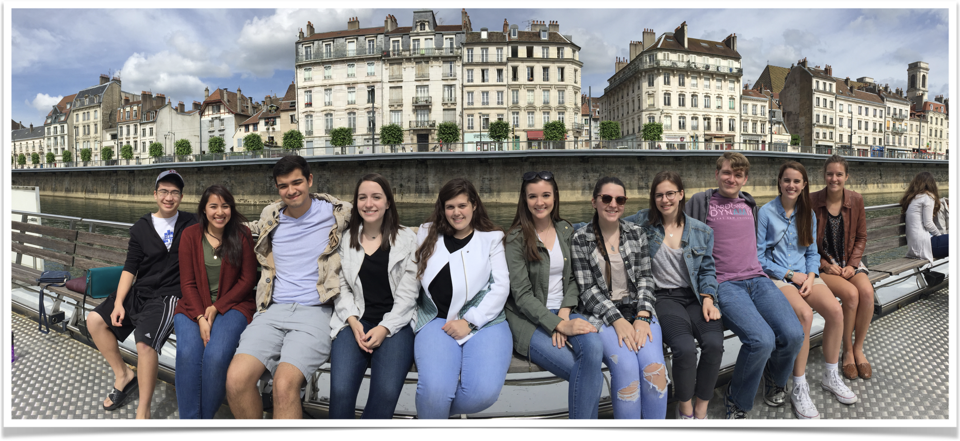
HOW MANY SPOTS?
The 2017 group
10

Slide 14
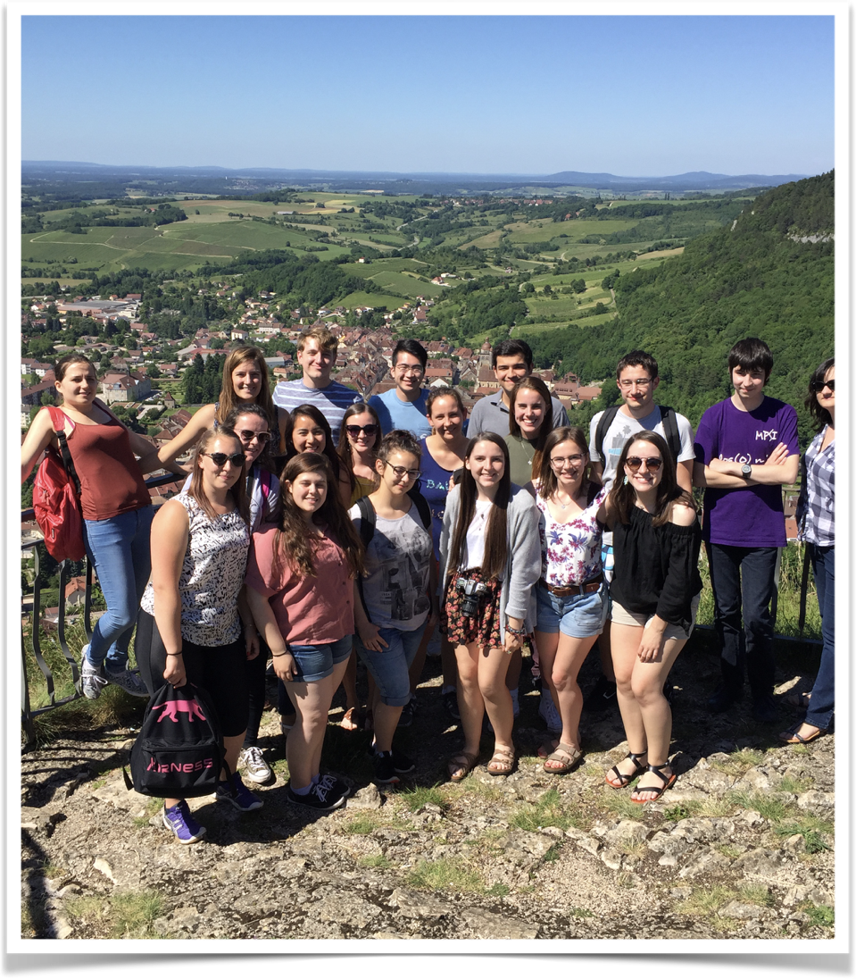
ESTIMATION OF THE COST
Tuition and fees: $2,200
Meals: $1,000
Accommodation: $700
----------------------------------------
Program related costs: $2,000
International Airfare: $1,400
Personal spending: up to you
----------------------------------------
Total estimated cost: $7,000-$8,000

Slide 15
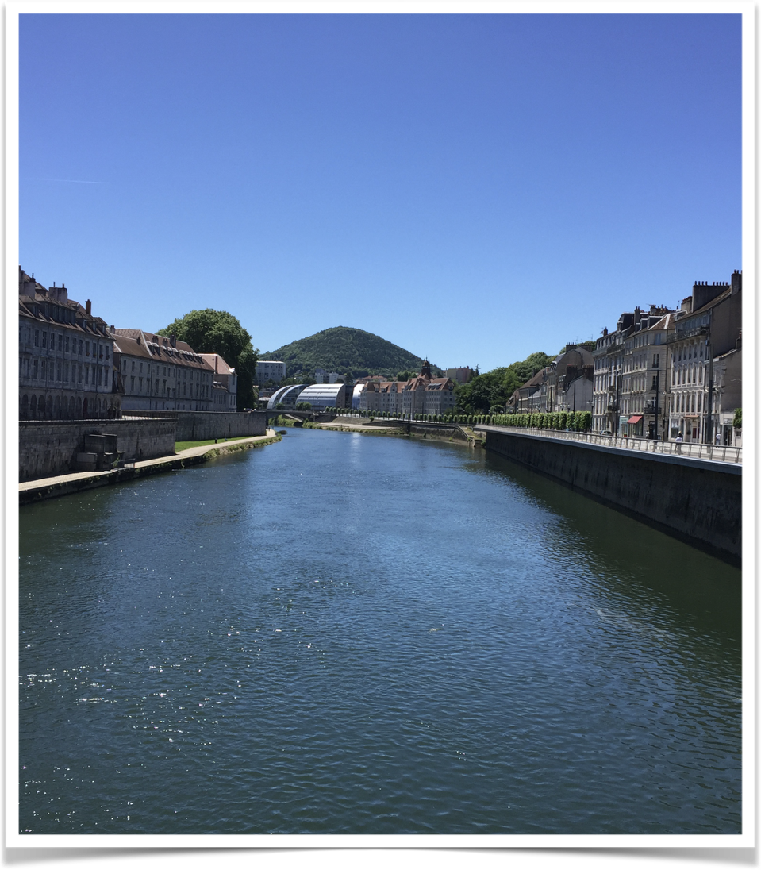
HOW TO FINANCE
personal funds
financial aids
scholarships

Slide 16
WHEN TO APPLY?
NOW
until December 1, 2019.

Slide 17
CONTACTS
Program leader: Dr. Florent Baudier
florent@math.tamu.edu
BLOC 525C
Program coordinator: Corinne Beverly
cbeverly@tamu.edu
Study Abroad Program Office at the Pavilion

Slide 18
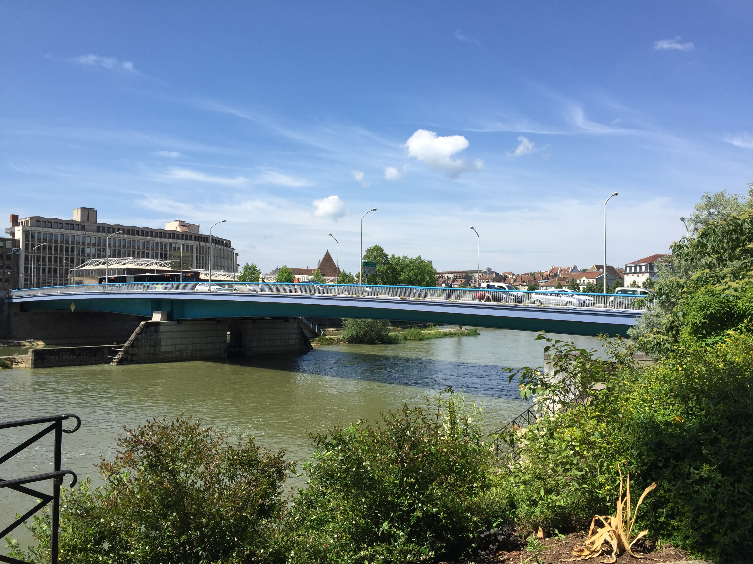
SEE YOU IN JUNE...

Slide 19
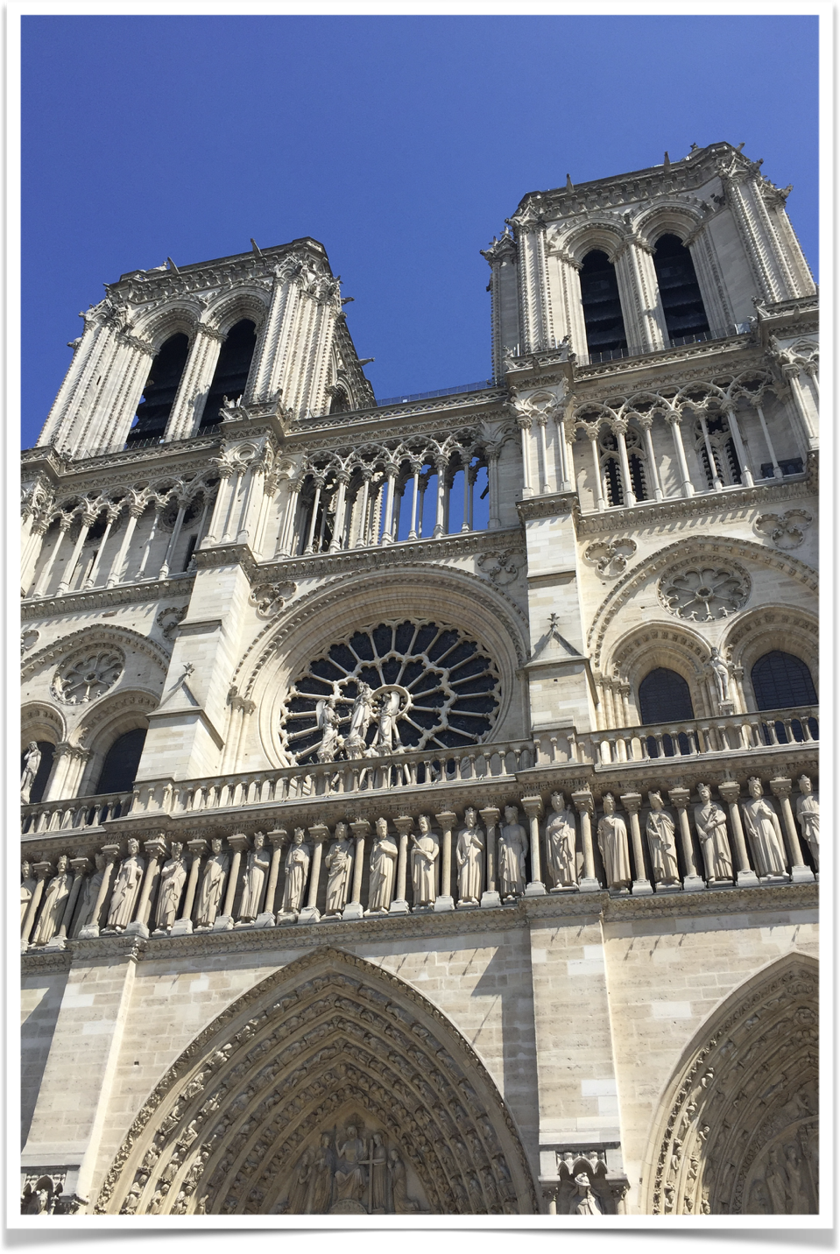
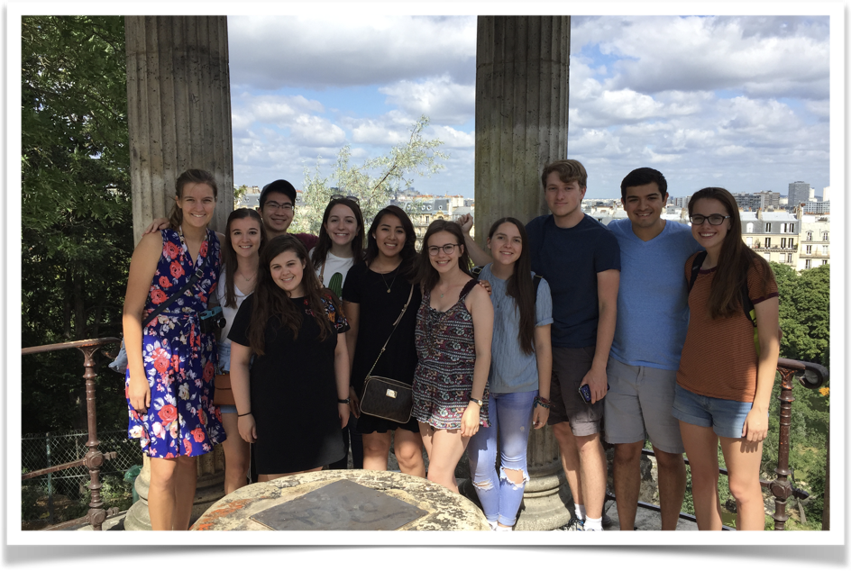
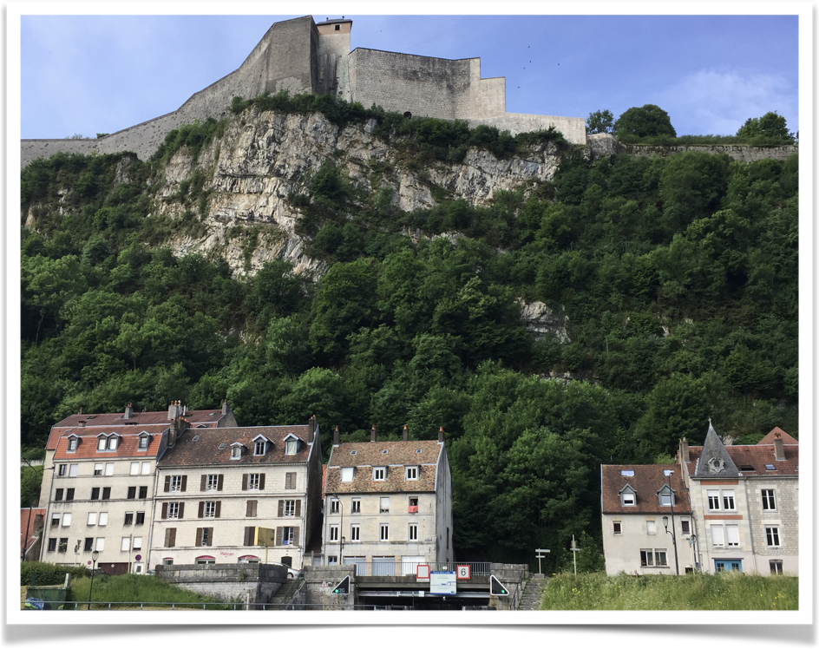
...in BESANÇON and PARIS

